Slide 1

Campus Track: intelligent
Lost and Found Application
A Smart Lost & Found Solution for Students
Lost and found application
Team Members:
Abhishek Singh
Ankitha Mudeti
Harsh Kumar
Prince Kumar
Mentored By:
Suramya Biswas

Slide 2


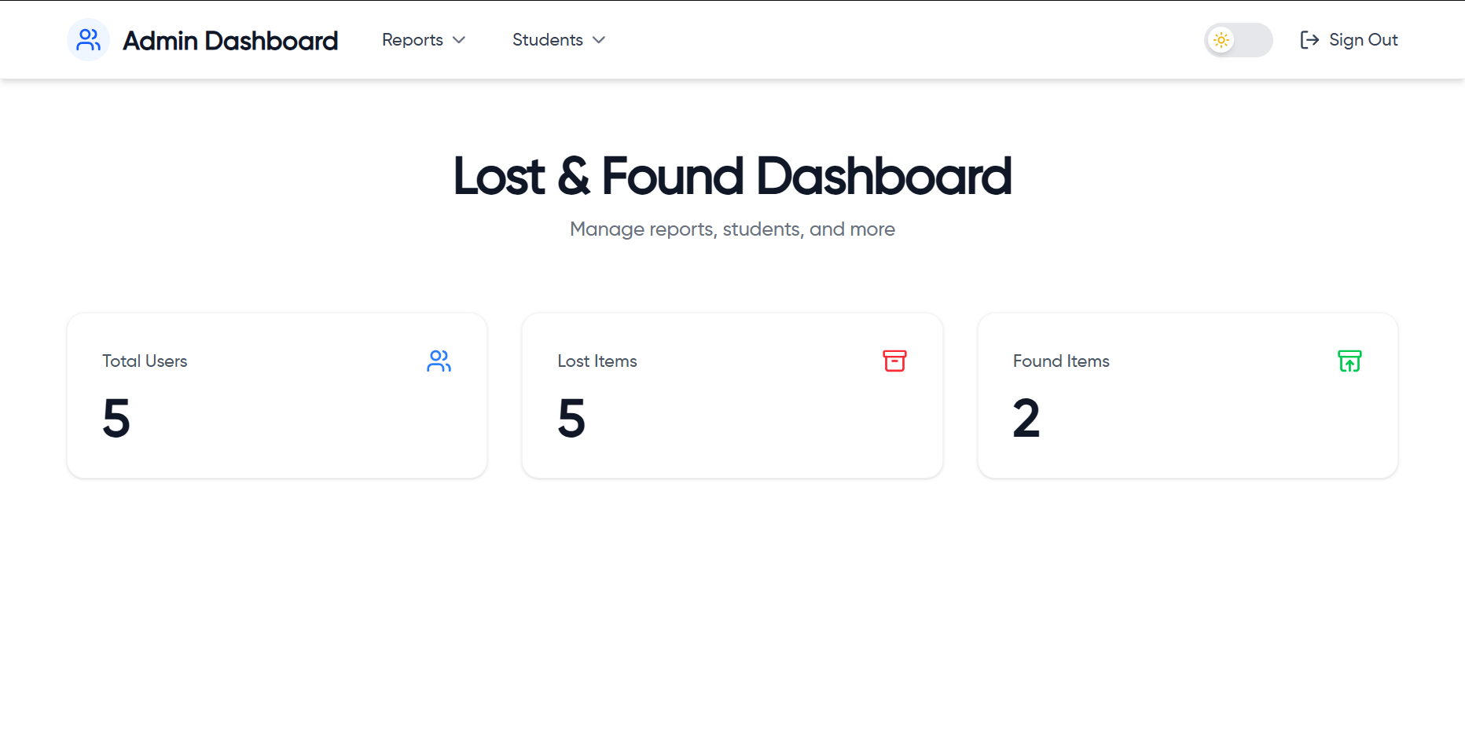
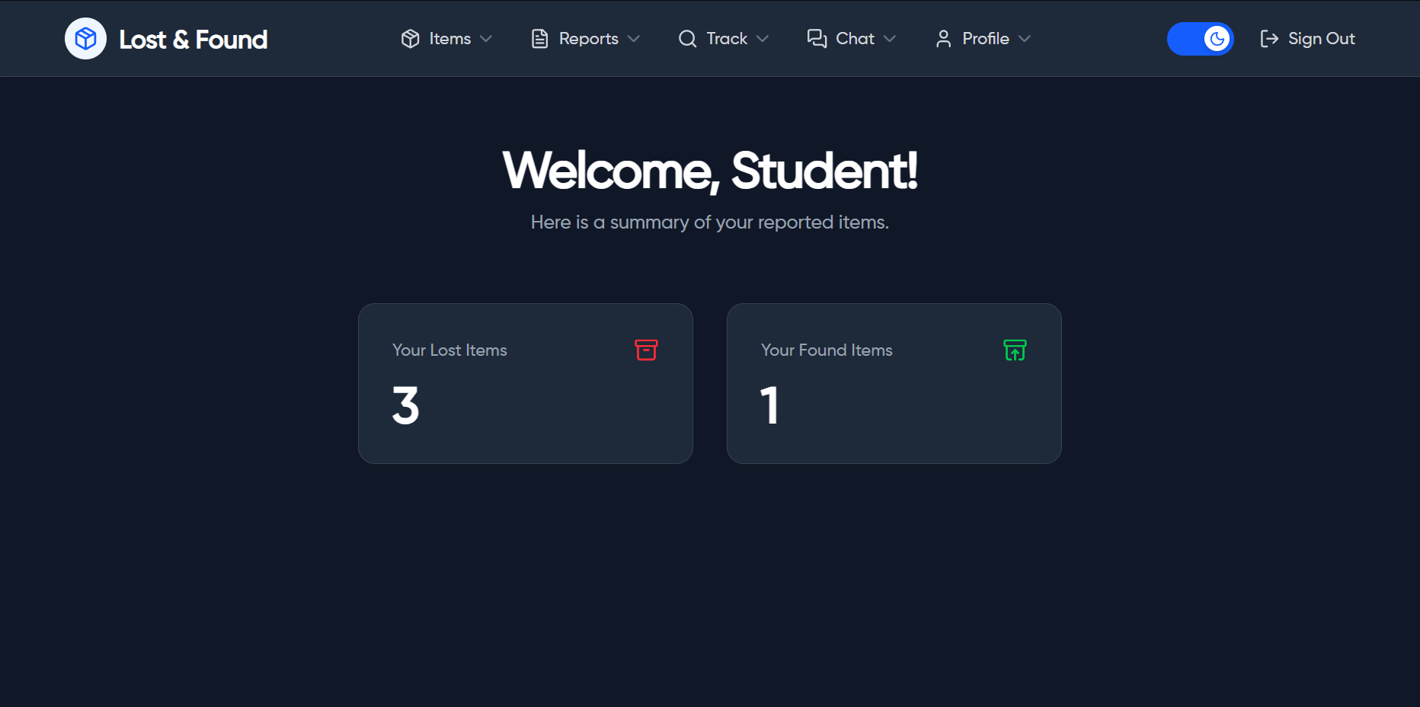
INTRODUCTION :
Problem
Students often lose personal items (ID cards, books, gadgets) on campus, and recovery relies on informal methods like word of mouth or group chats.
Lack of a centralized and secure system makes tracking and reporting lost/found items inefficient and time-consuming.
Lost and found application
Solution
A Campus-Exclusive Lost & Found web portal where students can post, search, and connect about lost or found items.
Features auto-matching, in-app chat, and an admin panel for monitoring and content management.

Slide 3
Spring Boot :
Spring Security :
Authentication
& Security
Backend Framework
objectives :
Spring Data JPA :
ORM/DB
Reactjs :
Create a Secure and campus-verified system.
Simplify item reporting, searching and matching.
Frontend Framework
Lost and found application
MySQL :
Database
Facilitates communication through in-app chat.
Provides analytics and moderation tools for Admins.
Tailwind :
WebSocket :
Real time Communication
Styling
Eclipse : Backend IDE
VS CODE :
Frontend IDE

Slide 4









Technology stack :
Spring Security :
Authentication
& Security
Spring Boot :
Backend Framework
Spring Data JPA :
ORM/DB
Reactjs :
Frontend Framework
Lost and found application
MySQL :
Database
Tailwind :
Styling
WebSocket :
Real time Communication
VS CODE :
Eclipse : Backend IDE
Frontend IDE

Slide 5








System Modules :
Authentication & Role Management
Auto-Matching & Search
Lost and found application
Admin Dashboard and Reporting
Chat System
Lost/Found Posting Form

Slide 6











Architecture :
Backend
Frontend
Database
Session based Authentication
Login/Register
Users
Role Based Access & Logic
Analytics Logs
Admin Dashboard UI
Lost and found application
RESTFUL APIs
Chat Messaging Logic
Flags
Chat Interface
Matches
Flag & Moderation
Lost/Found Post UI
Lost/Found Item
Post Matching Logic
handles upload
store image refs
upload images
Image Upload (Cloudinary)
upload images

Slide 7

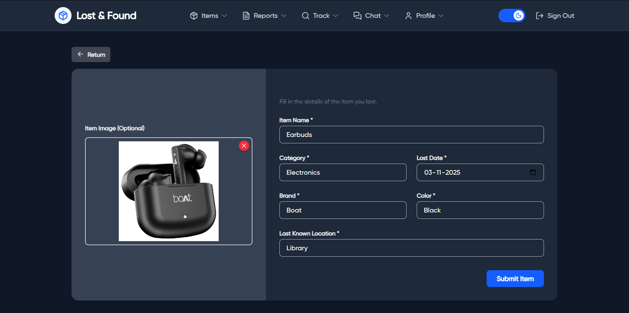
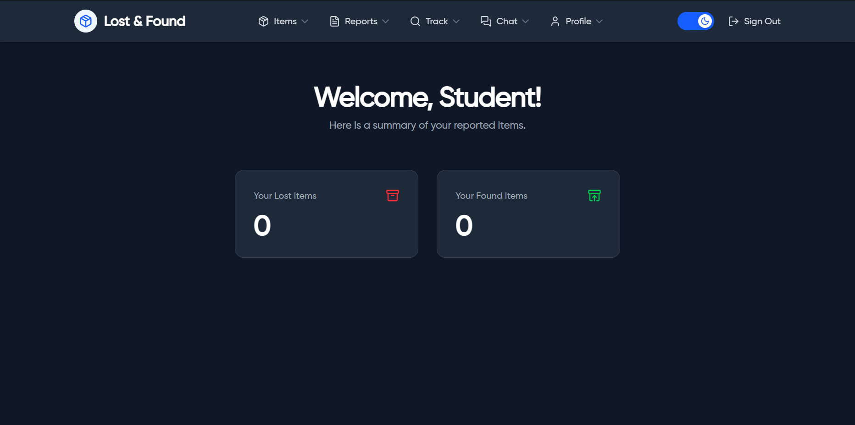
Workflow & DEMO :
1.
2.
Login/Register
Email Validation
Post Lost/Found Item
4.
Dashboard Access
3.
Lost and found application

Slide 8
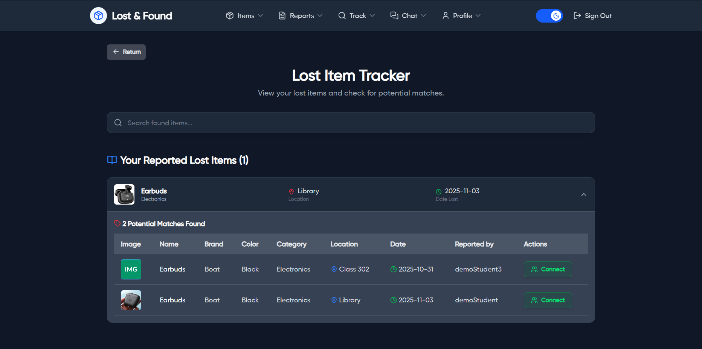
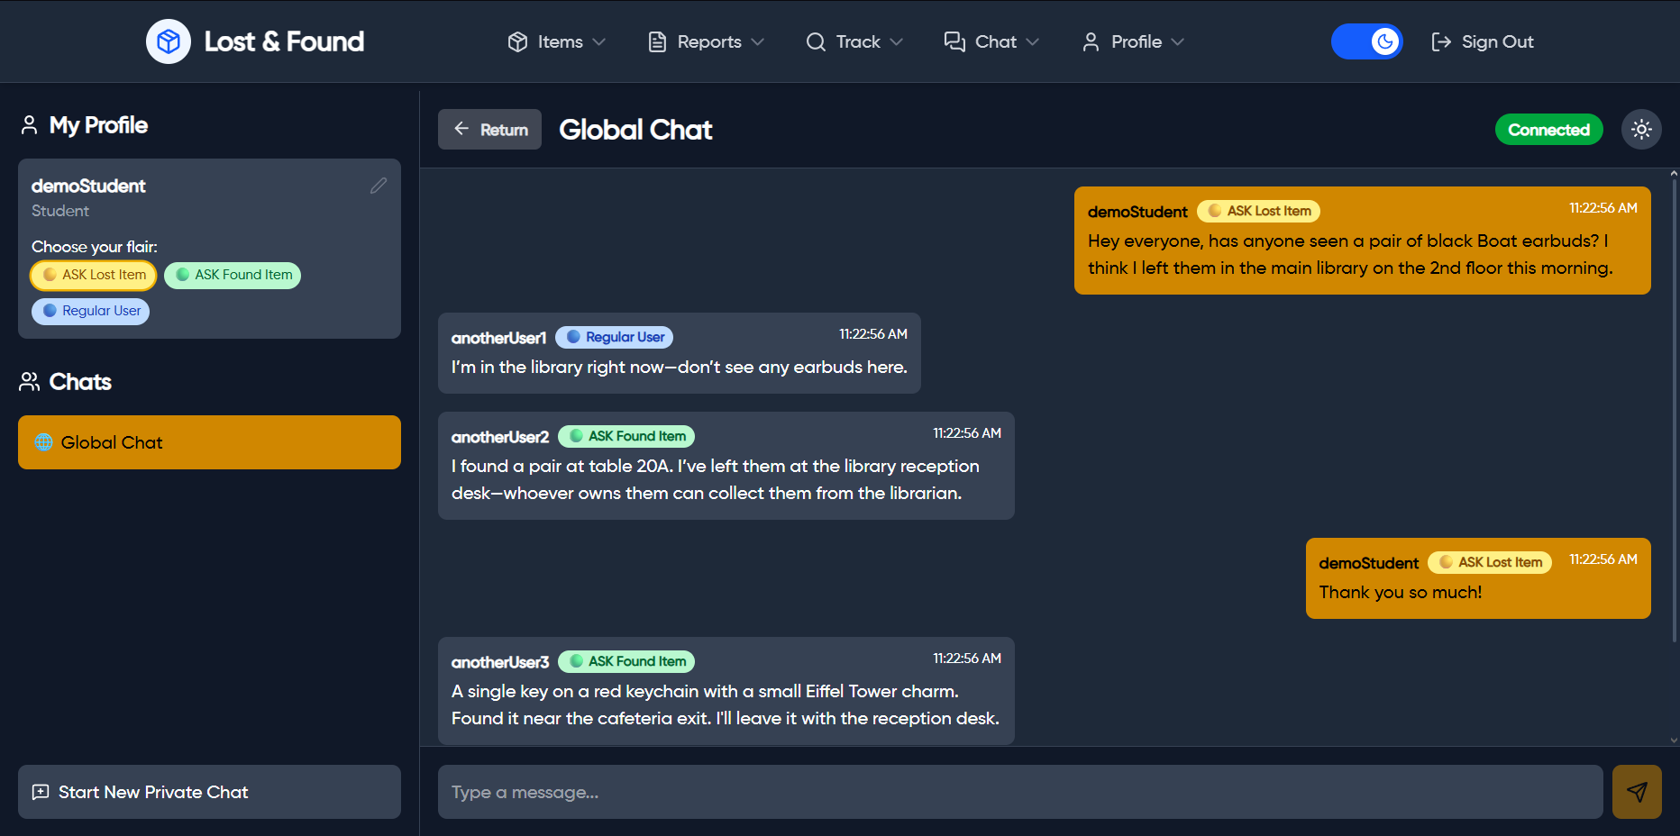
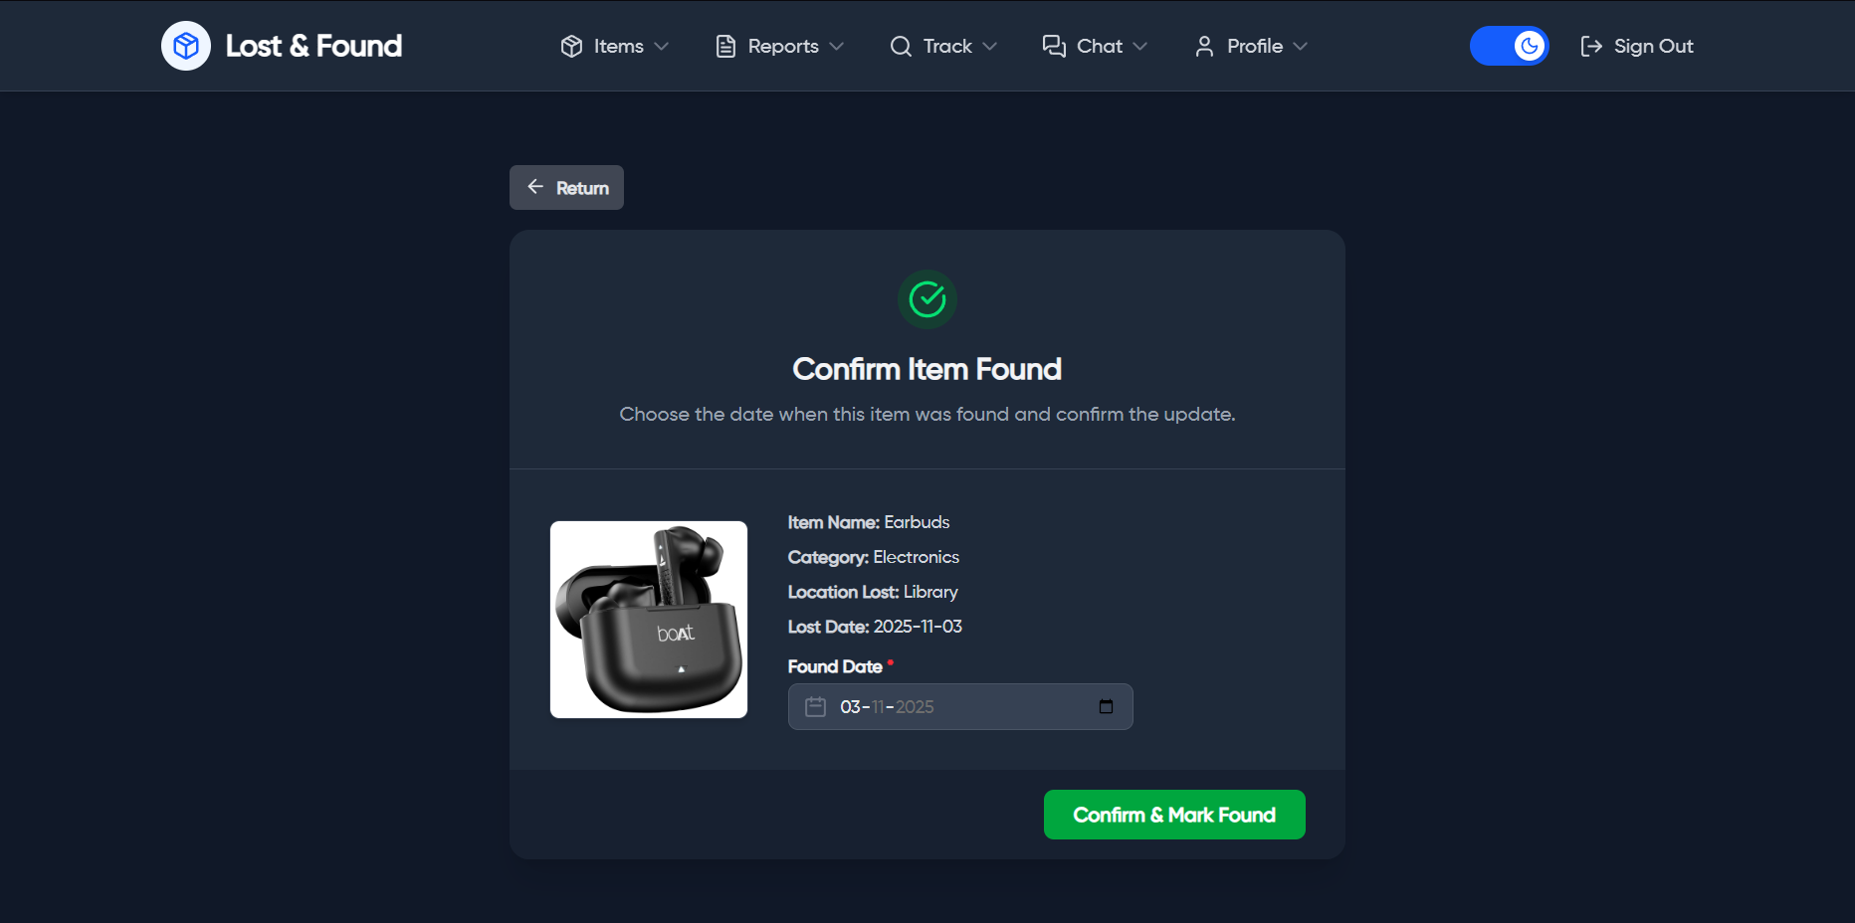
Workflow & DEMO :
Suggested Matches
+ Chat Option
5.
Auto Matching Algorithm
6.
Mark Item as Returned/Resolved
8.
Connect via In-App Chat
7.
Lost and found application

Slide 9
Workflow :
1.
USER
2.
Login/Register
3.
Email Validation
Post Lost/Found Item
5.
Dashboard Access
4.
Lost and found application
6.
7.
Suggested Matches
+ Chat Option
Auto Matching Algorithm
Mark Item as Returned/Resolved
9.
Connect via In-App Chat
8.

Slide 10
Simplified Recovery process within campus.
Real-time user interaction and admin moderation.
Accurate matching through keywords and location.
Result
Lost and found application
AI-based image recognition for matching.
Mobile App (React Native/Flutter).
Push Notification for new matches.
Cloud deployment for scalability.
Future Enhancements

Slide 11




Conclusion :
The Campus Lost & Found Portal provides a smart, campus-exclusive digital platform for managing lost and found items efficiently.
It ensures secure access, smooth communication, and quick item recovery through an organized and automated process.
Lost and found application
With its modular design, real-time chat, and admin moderation, the system enhances campus connectivity and trust.
The project lays the foundation for a scalable, AI-driven, and mobile-ready solution for modern educational institutions.

Slide 12

Conclusion :
The Campus Lost & Found Portal provides a smart, campus-exclusive digital platform for managing lost and found items efficiently.
thank YOU
It ensures secure access, smooth communication, and quick item recovery through an organized and automated process.
Lost and found application
With its modular design, real-time chat, and admin moderation, the system enhances campus connectivity and trust.
The project lays the foundation for a scalable, AI-driven, and mobile-ready solution for modern educational institutions.

